Slide 1


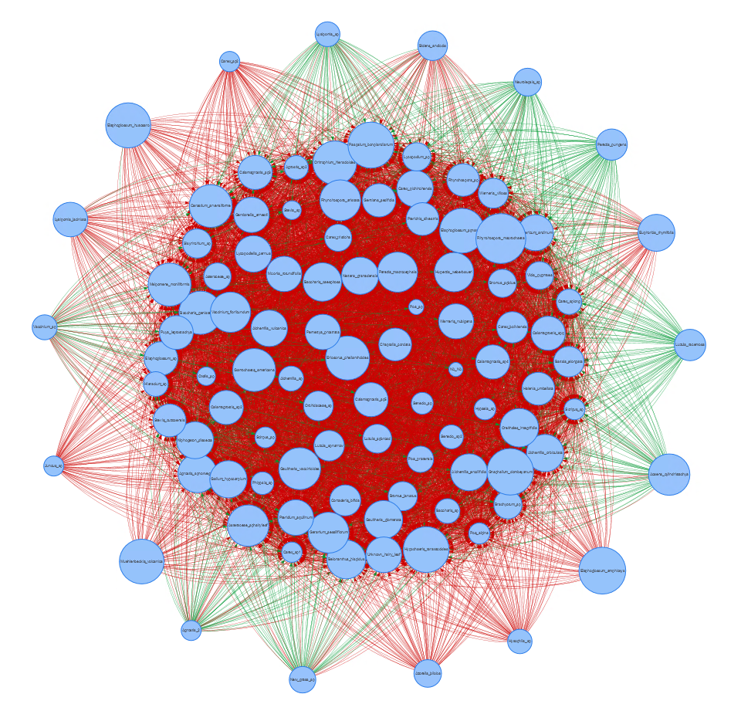
Data Simplification for Ecological Network Inference
Ecological Network Inference at Macroecological Scales
Malyon D. Bimler, DPhil, University of Queensland
James A. Lutz, Associate Professor, Utah State University
Alejandro Ordonez, Assistant Professor, Aarhus University
Notes:
Thank you for your interest in my work and welcome to the qualifying exam of my PhD Project focusing on Species-Interaction Networks as determinants and proxies of community assembly and ecosystem resilience.
So why do I study these things?

Slide 2

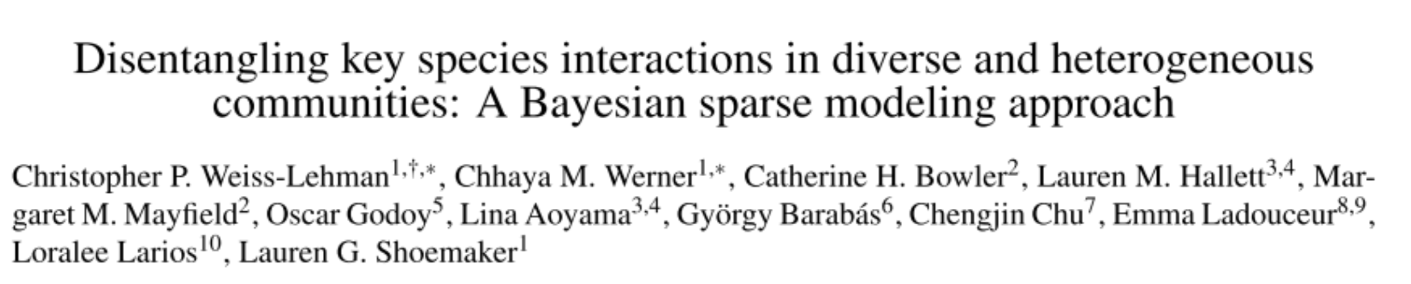

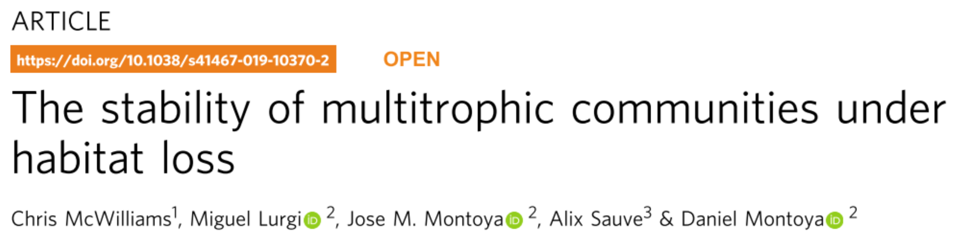
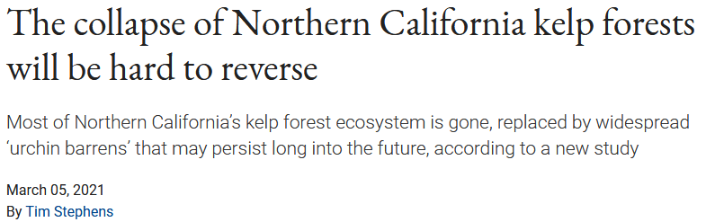
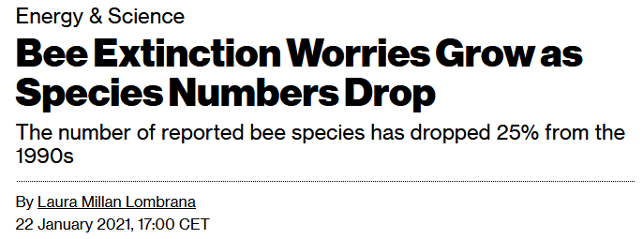

Ecological Networks & Macroecology
Networks help understand ecosystem processes
Implications for multiple disciplines of biology
Implications of ecological networks scale up
Particularly relevant for macroecological perspective
https://news.ucsc.edu/2021/03/kelp-forests-norcal.html
https://www.bloomberg.com/news/articles/2021-01-22/bee-extinction-worries-grow-as-species-numbers-drop

Slide 3
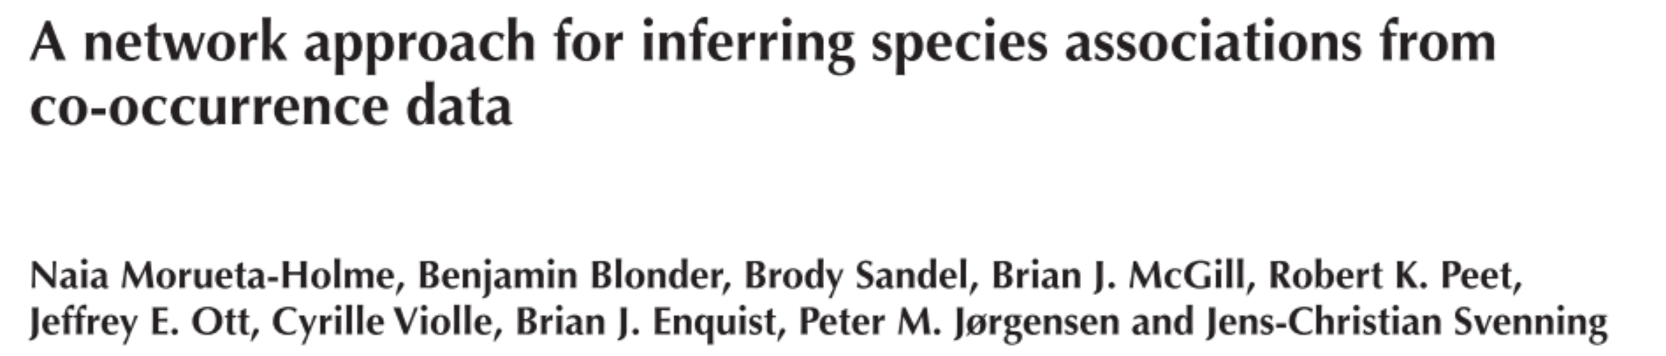


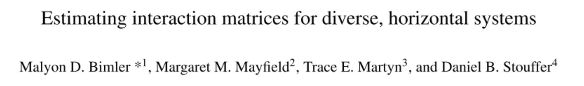

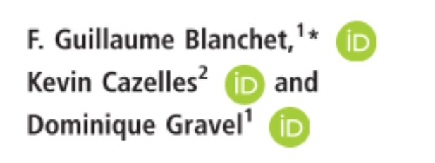
Inference of Ecological Networks
Observing ecological interactions is labour-intensive
→ Intractable at macroecological scales
Multiple frameworks for association/interaction inference have been proposed
Most analyse co-occurrence patterns
Co-Occurrence based methods for association/interaction inference have been critiqued
Research Questions:
→ Statistical inference of ecological networks
I | How relevant is the choice of inference method?
II | How scalable are inference methods and their networks?

Slide 4
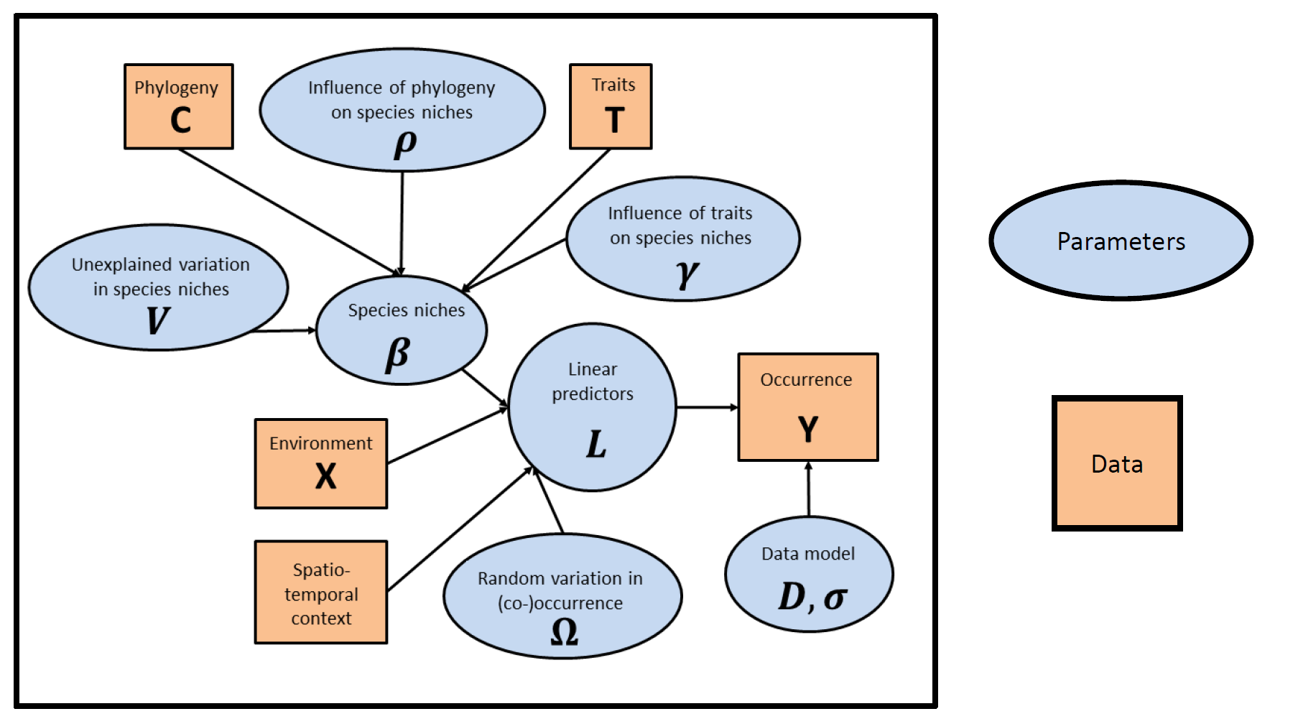










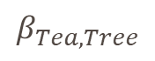
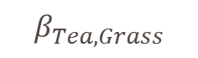

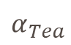
Network Inference Methods
Data Type | HMSC | IF-REM
Species Identity | X | X
Presence/Absence | X | X
Performance | ✓ | X
Climate / Environment | ✓
Functional Traits | ✓
Phylogeny | ✓
HMSC
IF-REM
A
B
A
$$P_{i}= α_{\left.Species[i\right]}+\sum_{i}^{j}{β_{\left.Species[i,j\right]}N_{\left.Species[j\right][i]}}$$
$$β_{Tea,Tree}$$
$$β_{Tea,Grass}$$
X … Non-Optional data
✓ … Optional data
B
$$β_{i,j }=r_{i }∗e_{j}$$
$$α_{Tea}$$

Slide 5






Data Simplification Across Scales
Data Sets
Local
Yosemite Forest Dynamics Plot
Pre-Fire
34,726 observations
Regional
Forest Inventory Analysis
Conifer Forest
Continental
Forest Inventory Analysis
✓ | ✓ | ✓ | ✓ | ✓ | ✓
✓ | ✓ | ✓ | ✓ | X | ✓
✓ | ✓ | X | ✓ | X | ✓
Geographic Scale

Slide 6

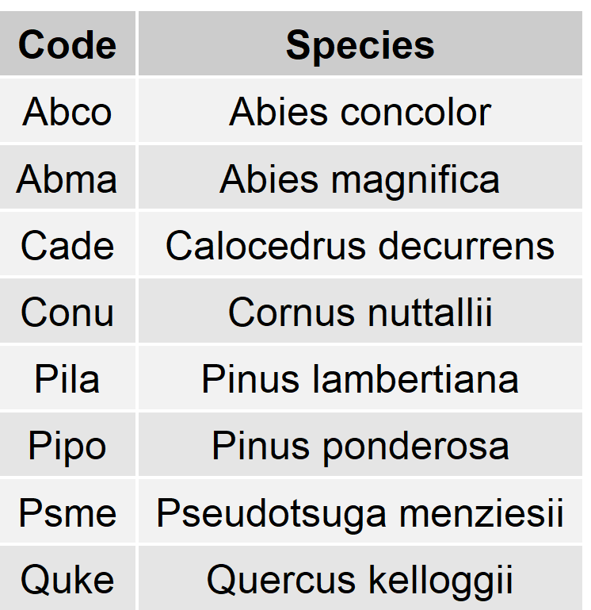
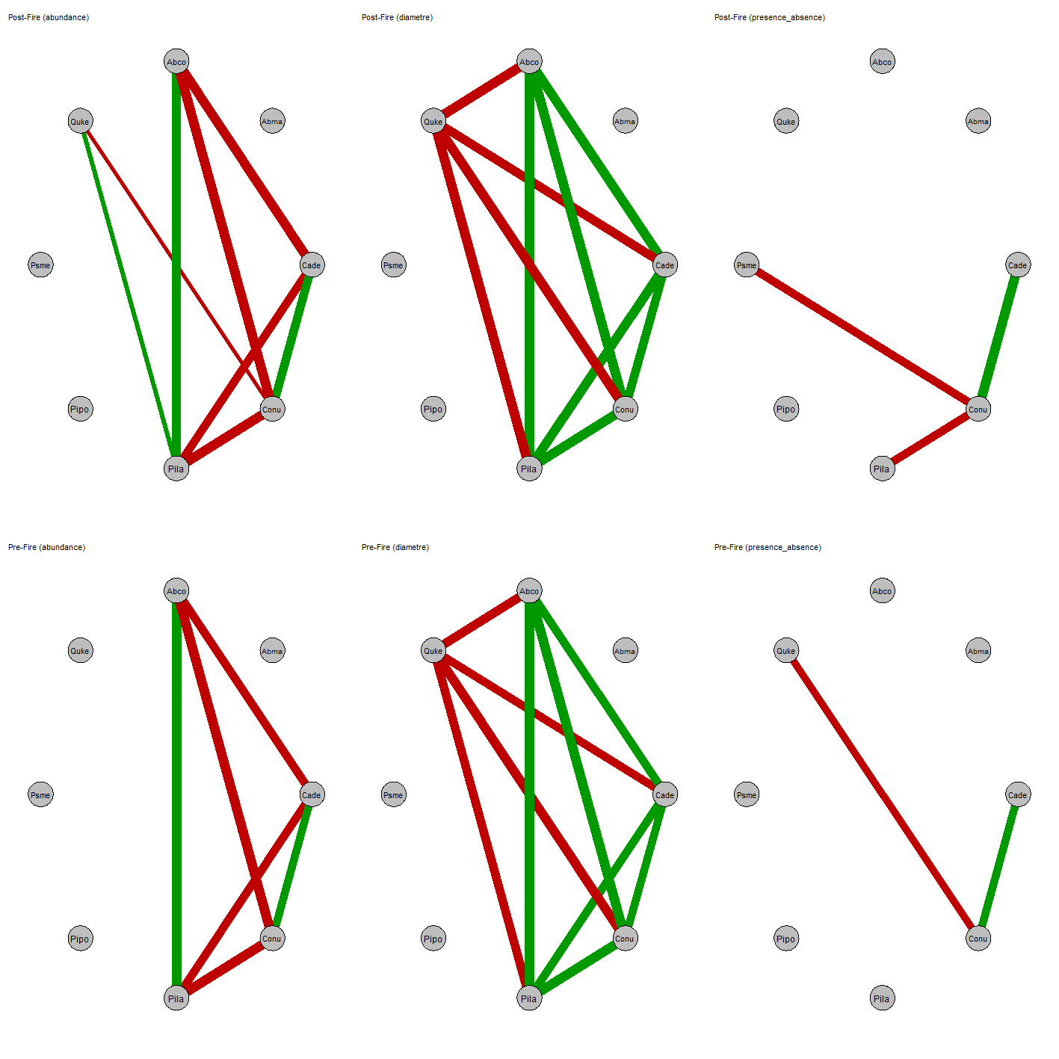
Species Attributes Are Most Informative
Yosemite
HMSC models allow varying specification of neighbourhood matrix:
Presence / Absence
Abundance
Diameter
Link Colour
Positive Association
Negative Association
Link Weight
Association Strength
Species attributes/performances enable identification of more associations!

Slide 7
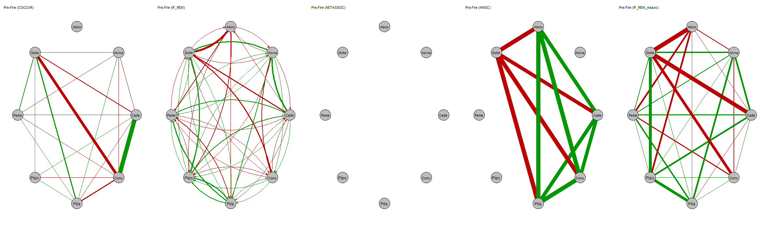
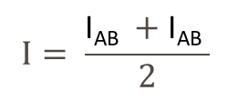


Association vs. Interaction
Yosemite
I_{AB}
IF-REM Associations
HMSC
IF-REM
I_{AB}
A
B
I_{BA}
I_{BA}
$$I= \frac{\text{I}\text{AB} +\text{I}\text{AB} }{2}$$
$$I$$
A
$$I$$
B
Inference of unobserved interactions populates networks.
Species attribute/performance methods show some consensus.
Not yet quantified!

Slide 8

Conclusion
@KuschErik
Implications
Future Directions
Quantification
Cross-Scale similarity
Cross-Method similarity
Network robustness
Method Development of IF-REM
Environmental effects
Traits / Phylogenetics
I | How relevant is the choice of inference method?
Species attributes/performances aid network inference
Inference of missing connections changes network topology drastically
II | How scalable are inference methods and their networks?
Early results show inconsistency in inferred networks across geographic scales.

Slide 9
Ecological Interactions and their Networks
Biological Interactions:
“presence of a species has some influence on the occurrence of another”~ Blanchet et al., 2020
Any impact of one species on fitness of another
Two types of ecological networks:
A
A
Interaction | Association
Directed
Commensalism (+/0), Amensalism (-/0) Parasitism (+/-), Predation (+/-) Competition (-/-), Mutualism (+/+)
Undirected
Competition (-/-), Mutualism (+/+)
B
B

Slide 10

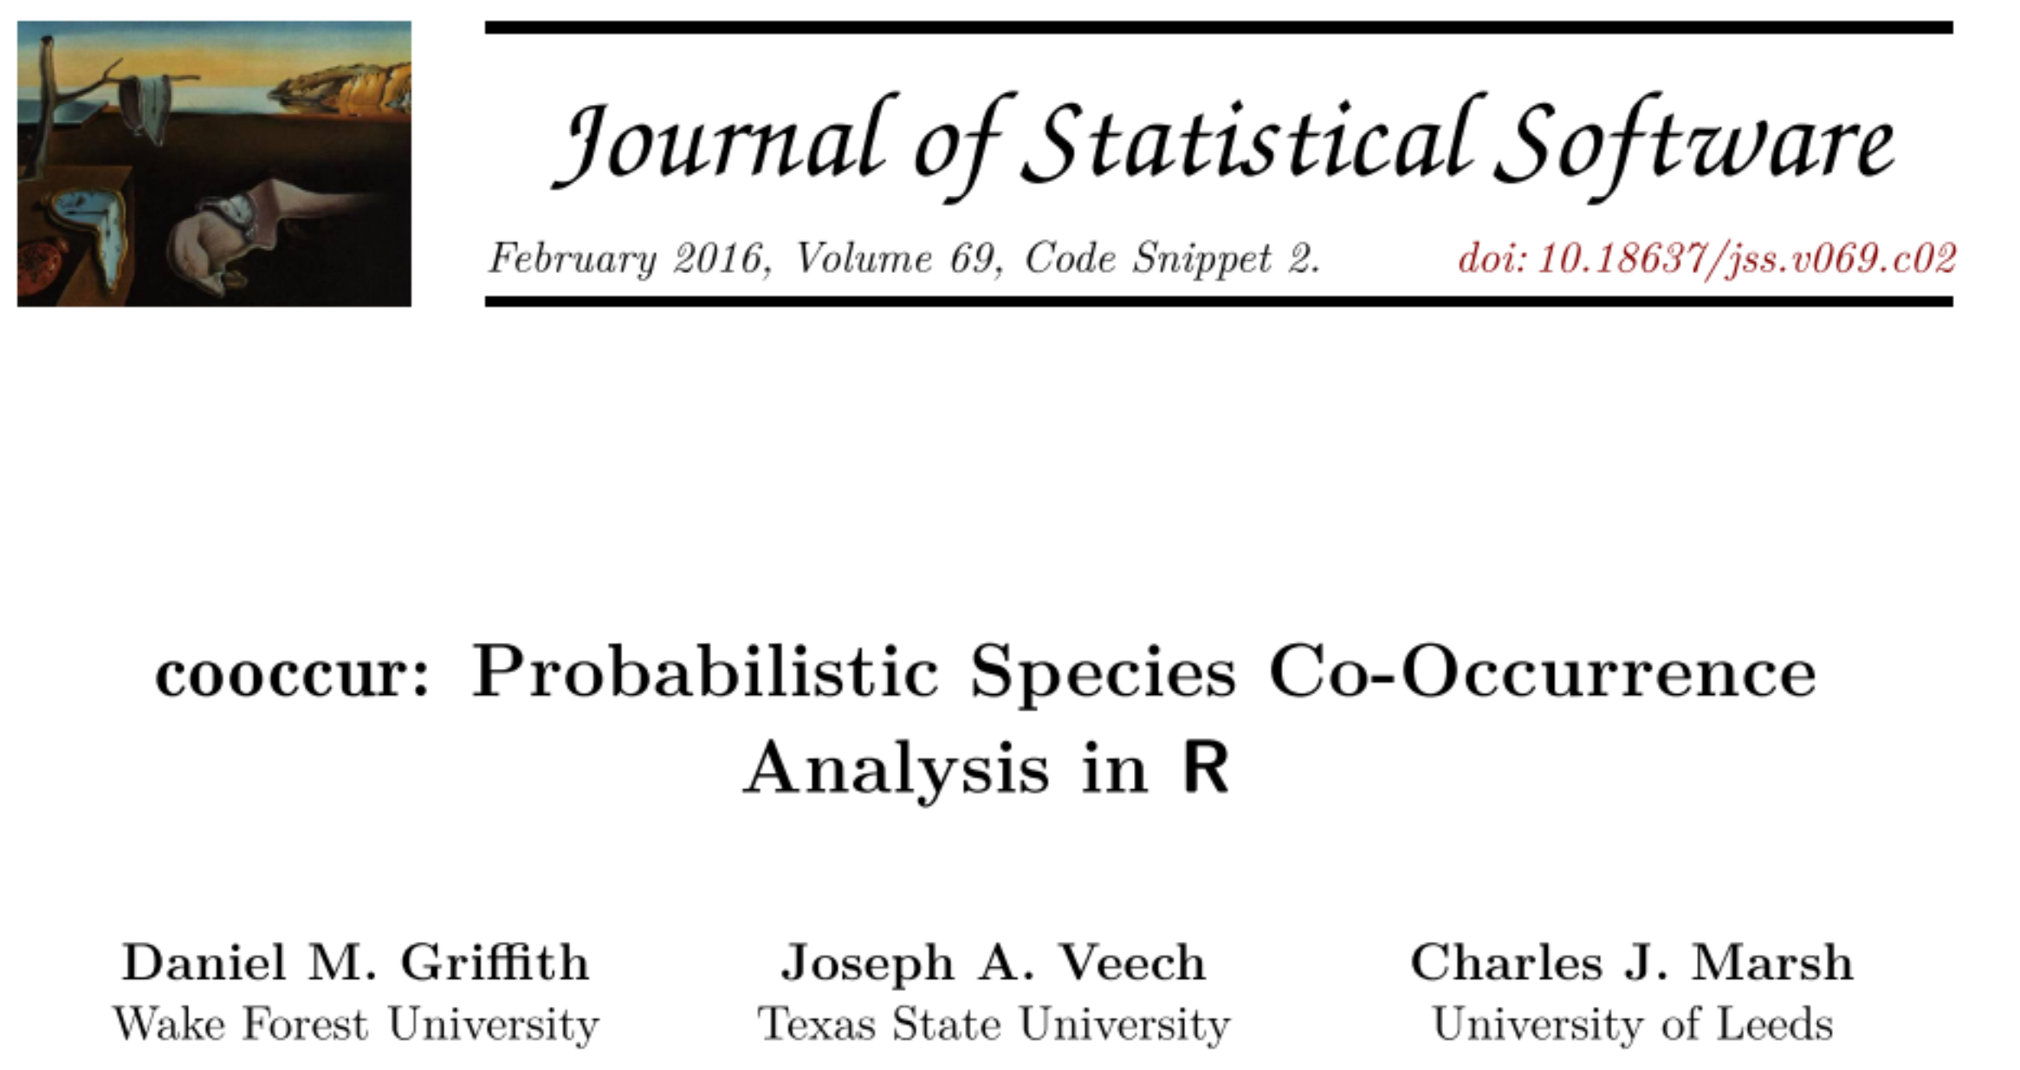
Cooccur
A
B
Core Principle:
Probabilistic model of co-occurrence rates
Benefit:
Little data requirements
Easy-to-implement
Computationally inexpensive
Shortcomings:
Environmental effects
Multiple associations
Data Type | Optional
Species Identity
Presence/Absence

Slide 11


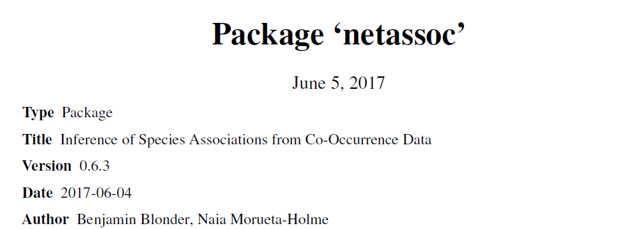
Netassoc
A
B
Core Principle:
Gaussian graphical model
Benefit:
Moderate data requirements
Corrects for indirect effects of multiple associations
Avoids spurious associations at regional-scales
Shortcomings:
Leverages abundance
→ More informative than co-occurrence
Null expectations (SDM outputs) may bias results
→ Largely due to subpar climate data practices in biology
Data Type | Optional
Species Identity
Presence/Absence
Null Expectation of Occurrence

Slide 12


HMSC
A
B
Core Principle:
Bayesian Hierarchical Modelling of Species Communities
Benefit:
Can use species attributes (e.g. performance)
Highly modular
Environmental effects
Traits and phylogenetics
Shortcomings:
Potentially high data requirements
Difficult-to-implement
Computationally expensive
Data Type | Optional
Species Identity
Presence/Absence
Performance
Climate / Environment
Functional Traits
Phylogeny

Slide 13
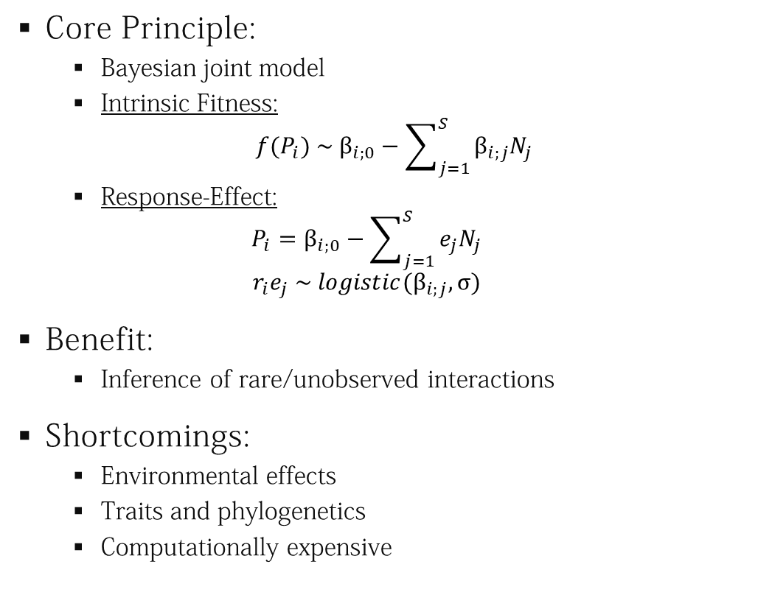
IF-REM
A
B
Core Principle:
Bayesian joint model
Intrinsic Fitness:
$$f{(P}_{i}) \sim β_{i;0}−\sum_{j=1}^{S}{β_{i;j}N_{j}}$$
Response-Effect:
$$P_{i}=β_{i;0}−\sum_{j=1}^{S}{e_{j}N_{j}}$$
$$r_{i}e_{j} \sim {logistic(β}_{i;j}, σ)$$
Benefit:
Inference of rare/unobserved interactions
Shortcomings:
Environmental effects
Traits and phylogenetics
Computationally expensive
Data Type | Optional
Species Identity
Presence/Absence
Performance

Slide 14

Data Simplification Across Scales
Data Sets
Local
Yosemite Forest Dynamics Plot
Pre-Fire
34,726 observations
Post-Fire
35,791 observations
Regional
Forest Inventory Analysis
Conifer Forest
485,907 observations
Continental
Forest Inventory Analysis
Geographic Scale

Slide 15



Data Across Scales
Geographic Scale
Local
Yosemite Forest Dynamics Plot
Pre-Fire (34,726 observations)
Post-Fire (35,791 observations)
Regional
Forest Inventory Analysis
Broadleaf Forest (1,562,880 observations)
Conifer Forest (485,907 observations)
Continental
Forest Inventory Analysis
Data Simplification
Data Type | Data Type | Local | Regional | Continental
 | Species Identity
 | Presence/Absence
 | Performance
 | Climate / Environment
 | Functional Traits
 | Phylogeny
 | Null Expectation

Slide 16
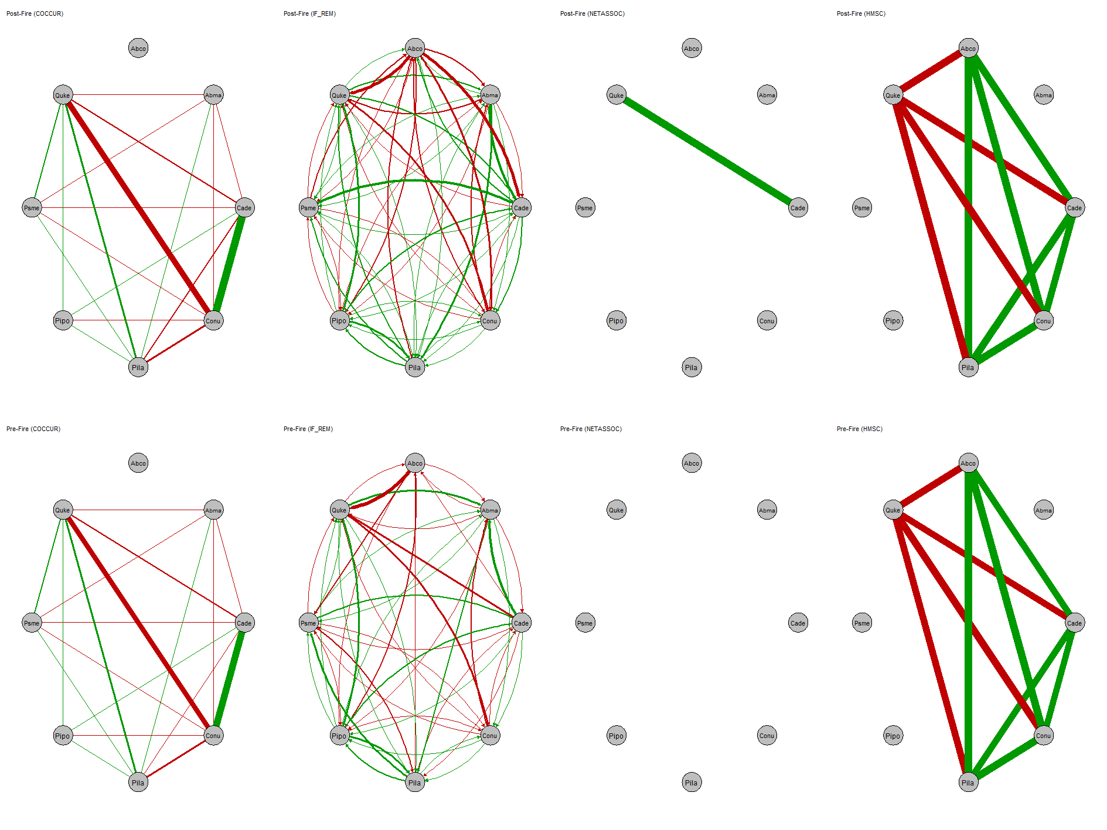
Co-Occurrence Methods
Yosemite
COOCCUR
NETASSOC
Co-Occurrences at Local Scale
No major environmental gradients
Association signals are lost when accounting for multiple interactions and null expectations of co-occurrence.
Resulting networks are not useful.
Co-Occurrence methods are unsatisfactory.

Slide 17
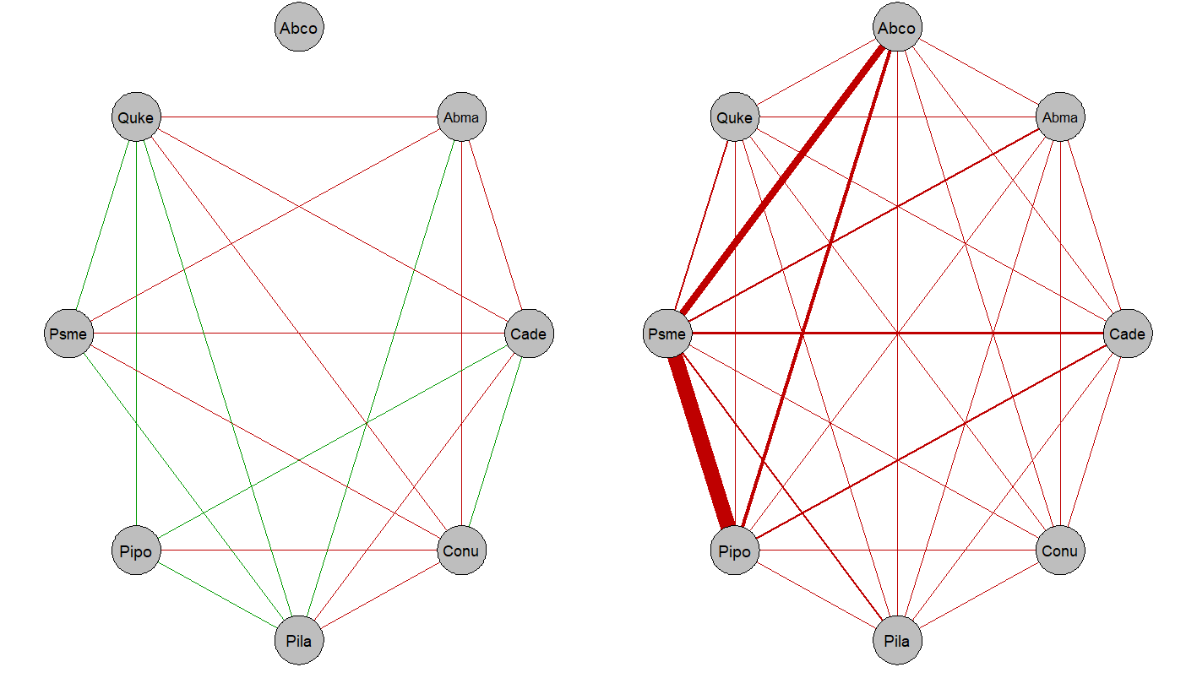
Cross-Scale Network Changes
Yosemite
Forest Inventory Analysis
Association inference not consistent across scales.

Slide 18
Network Robustness to Fire
Yosemite
COOCCUR
IF-REM
NETASSOC
HMSC
Associations/Interactions within coniferous forest species in Yosemite seems robust to fire events.

Slide 19
Network Robustness to Fire
Yosemite
IF-REM
HMSC
Associations/Interactions within coniferous forest species in Yosemite seems robust to fire events.
We need to test this more!

Slide 20
Conclusion
Implications
Co-Occurrence methods are unsatisfactory
→ Corrections for isolated 1-1 associations rendered networks too sparse to use
Species attributes/performances aid inference
→ The more information an association method levies, the more associations can be inferred
Inference of rare/unobserved connections
→ Inference of missing connections changes network topology drastically
Lack of consistency of inferences across scales
→ Different ecological interpretation at different scales
Future Directions
Quantification
Cross-Scale similarity
Cross-Method similarity
Network robustness
Method Development of IF-REM
Environmental effects
Traits / Phylogenetics
Always be sure to specify the spatial context and use methods which incorporate information about species attributes/performance.

Slide 21











Icons
https://www.freepik.com/
https://www.freepik.com/
https://www.flaticon.com/authors/maxim-basinski-premium
https://www.flaticon.com/authors/ddara
https://www.flaticon.com/authors/smalllikeart
https://creativemarket.com/Becris
https://www.flaticon.com/authors/vectors-market
https://www.freepik.com
https://www.flaticon.com/authors/flat-icons
https://www.flaticon.com/authors/ddara
https://www.freepik.com
https://www.freepik.com/
https://www.freepik.com

Slide 22
Ecosystem Resilience & Interaction Networks
Ecosystem Resilience
Capability of withstanding perturbation (Holling, 1973)
Pivotal to resource management (Brown & Williams, 2015)
Requires empirical understanding (Newton, 2016)
Interaction Networks
Track extinction cascades (Oliver et al., 2015)
Determine:
Species-persistence (Gaiarsa et al., 2021)
Community assembly (Maia et al., 2021)
Community stability (Neff et al., 2021; McWilliams et al, 2019)
Capture more information than biodiversity assessments (Baroni et al., 2021)
https://news.ucsc.edu/2021/03/kelp-forests-norcal.html
Biological interactions allow us to study ecosystem resilience.
https://www.bloomberg.com/news/articles/2021-01-22/bee-extinction-worries-grow-as-species-numbers-drop
Notes:
3.20
The question of motivation is probably best addressed through the lens of ecosystem resilience …
Instances of failing ecosystem resilience capture the public’s attention. As such ecosystem resilience can be studied through a multitude of avenues. However, some of the most drastic examples and those most vivid in our collective perception display drastic developments such as extinction cascades
These are best studied through interaction networks
Interaction networks tell us much more than “just” extinction cascades
→ Studying biological interactions allows us to understand ecosystem resilience

Slide 23


What Is An Interaction?
https://www.freepik.com/
Common-Sense Interactions:
“mutual or reciprocal action or influence”~ Merriam-Webster
Biological Interactions:
“presence of a species has some influence on the occurrence of another”~ Blanchet et al., 2020
Any impact of one species on fitness of another
Types of interactions:
Mutualism (+/+)
Commensalism (+/0)
Predation/Herbivory/Parasitism (+/-)
Competition (-/-)
https://www.flaticon.com/authors/pixel-perfect
https://www.flaticon.com/authors/vectors-market
Association
Undirected
Acknowledges lack of process-information
Interaction
Directed
Conveys certainty of processes

Slide 24
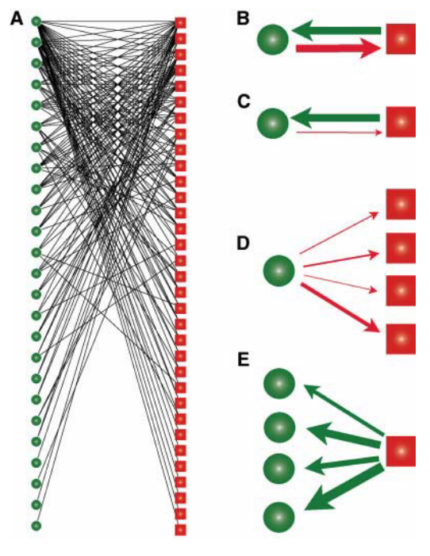
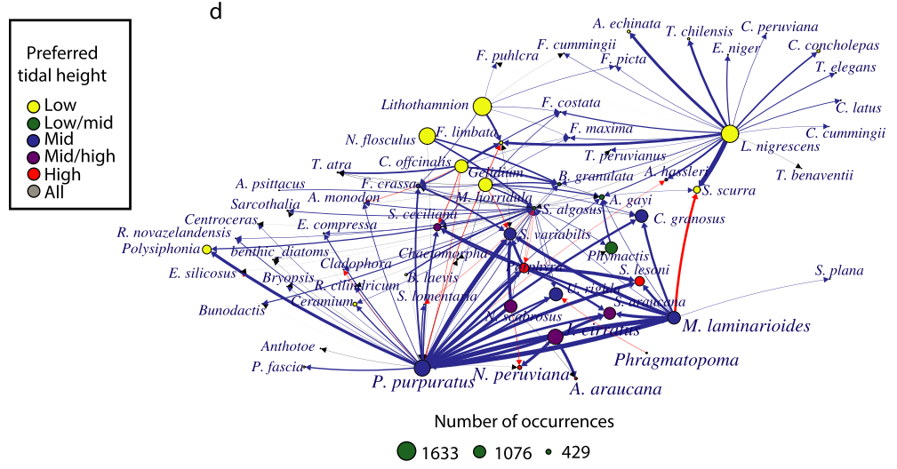
Biological Interaction Networks
1-1
n-1
A network is a universe interaction motifs
Establish interaction chains
Too simple to understand ecosystem resilience and trophic cascades
Ecosystem-/community-level patterns require interaction networks
Complex & difficult to investigate
Bascompte et al., 2006
Reduce information in interaction network to relevant proxies for community structure and ecosystem/community resilience.
Freilich et al., 2018

Slide 25
Network Topology
A
B
Networks consist of:
Topology: Metrics detailing the arrangement of edges and vertices in network
Edge
Vertex
Vertex
Network-Level
Modularity
Nestedness
Redundancy
Ascendancy
…
Vertex-Level
Centrality
Distance
Degree
Interaction Sign
…
Morueta-Holme et al., 2016 & González‐Castro et al., 2021 & Fortuna et al., 2010
Notes:
What is topology? Look up a definition

Slide 26

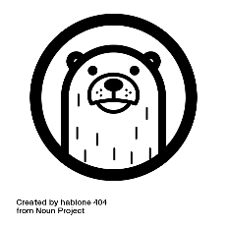




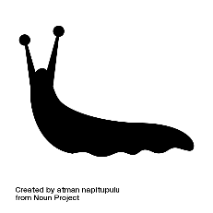

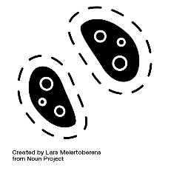

Network-Level Topology
Modularity
Degree to which there exist distinct clusters
Redundancy
Portion of vertices with similar edge constellations
Nestedness
Specialisation asymmetry
Smith et al., 2021
Hughes et al., 2014

Slide 27
Centrality
Degree
Importance by number of edges
Betweenness
Relevance for shortest edges in network
Closeness
Smallest distance to all other vertices in network
Smith et al., 2021
Hughes et al., 2014

Slide 28


Interactions in Context
Shaped by a multitude of factors:
Climate
Do species share locations?
Phylogeny
Do species share evolutionary history?
Functional Traits
How similar are species?
Complexity increases when adding:
Species
Trophic Levels
Climatic Variables
Functional Traits
vs.
?
?
Notes:
4.50
So how do biological interactions form?
…
Now, how do we go about studying biological interactions.

Slide 29
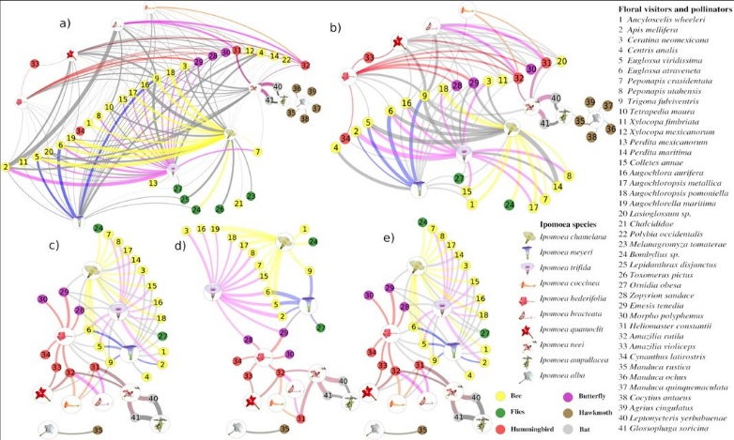
Studying Biological Interactions
Site-Based
Observations of direct interactions in nature
Immense data and sampling requirements
Constrained to a limited number of species and geographical scale
Biogeographical/Macroecological
Inference of interactions from co-occurrences
Limited only by data availability
Scalable:
Highly-Localised (González‐Castro et al., 2021)
Biogeographical Regions (Galiana et al., 2021)
Biogeographical Realm (Morueta-Holme et al., 2016)
Potentially executable at global scale
Data needs and potential at different scales
de Santiago-Hernández et al., 2019
Macroecological perspective poised to address large-scale issues of the Anthropocene.
Notes:
7.10
Two approaches to studying biological interactions

Slide 30
Current Methodological Perspective
Data
Presence/Absence
Fitness
Methodology
Null-model testing
Linear models
Output
associations
interactions
Notes:
8.15
These have been proven powerful and provide insight.

Slide 31





Overview of the PhD Project
Species-Occurrence Data
Network-Methodology
Network Topology
Climate Data in Biological Analyses
Cross-Scale
Biodiversity Simplification
Cross-Trophic
vs.
Novel climate data for accurate identification of environmental contributions to interactions.
Network topology and trait/phylogeny impacts across scales.
Simulation of extinctions and their consequences.
Extinction cascades across and within trophic levels.
?
?
Ecosystem Resilience
Notes:
12.18
Methods so far are missing key components:
Chapters referenced by colour
Prepare “methodology” and then actual research questions
“First we need to talk about methodology”

Slide 32
Data Simulation & Method Selection
Current Work:
Simulation study to assess method quality
Input
1-1 Interactions
Data
Simulation of fitness
Analysis
HMSC (Tikhonov et al., 2020 & Opedal et al., 2020)
COOCCUR (Griffith et al., 2016)
Intrinsic Fitness
Netassoc (Morueta-Holme et al., 2016)
Notes:
13.00
“We want to build on existing methodology, but which one do we build from?”

Slide 33

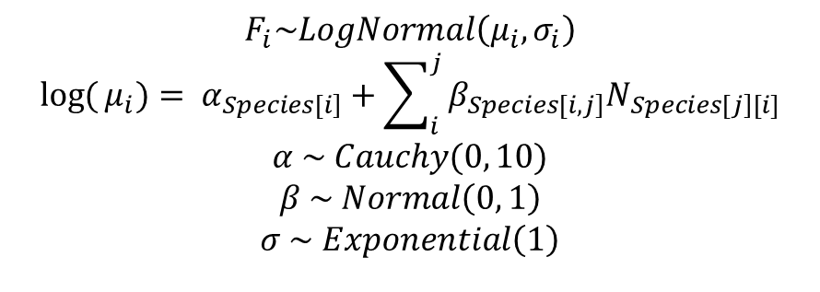

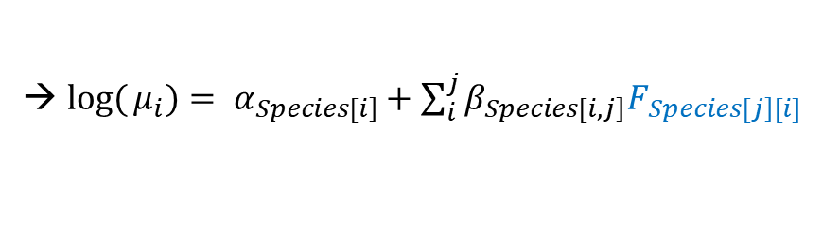
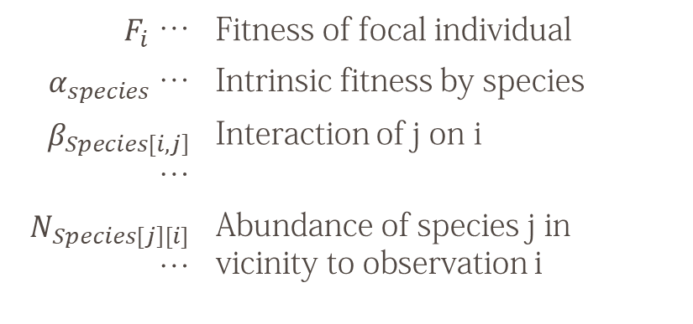

Method Development – Intrinsic Fitness
Intrinsic Fitness:
Bayesian Method
Distributional estimates
Infer unobserved/rare interactions
Directed Effects
$$F_{i}\sim LogNormal\left(μ_{i},σ_{i}\right)$$
$${\log{(}μ}_{i})= α_{\left.Species[i\right]}+\sum_{i}^{j}{β_{\left.Species[i,j\right]}N_{\left.Species[j\right][i]}}$$
$$α \sim Cauchy(0, 10)$$
$$β \sim Normal\left(0, 1\right)$$
$$σ \sim Exponential\left(1\right)$$
$F_{i}$ … | Fitness of focal individual
$α_{species}$ … | Intrinsic fitness by species
$β_{\left.Species[i,j\right]}$ … | Interaction of j on i
$N_{\left.Species[j\right][i]}$ … | Abundance of species j in vicinity to observation i
$$β_{Tea,Tree}$$
$$β_{Tea,Grass}$$
Trade-off of abundance & individual fitness?
→ ${\log{(}μ}_{i})= α_{\left.Species[i\right]}+\sum_{i}^{j}{β_{\left.Species[i,j\right]}F_{\left.Species[j\right][i]}}$
$$α_{Tea}$$
Notes:
16.20
This is where I am currently, Everything hereafter are plans

Slide 34
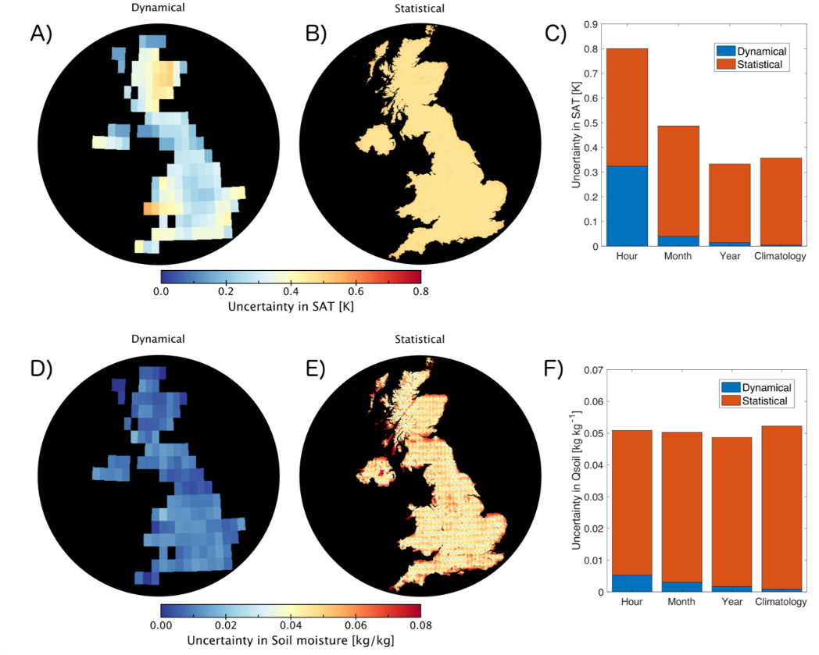
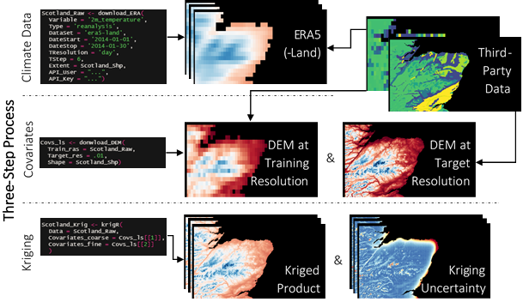


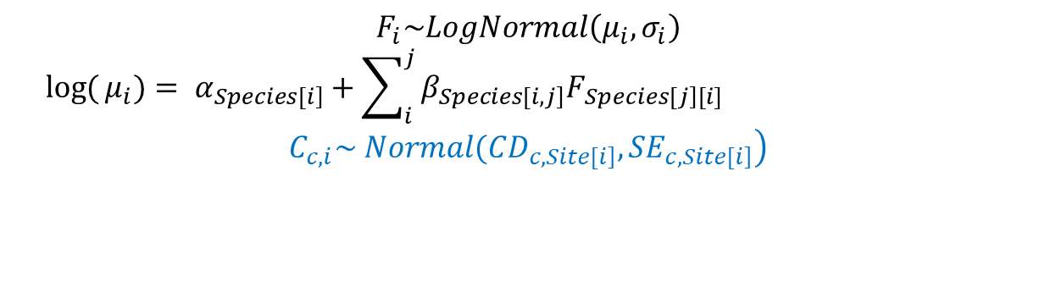
Method Development - Environment
Environment |  | "Species may simply co-occur because they favor the same abiotic conditions"
Accounting for environmental variation:
Latent variables (Ovaskainen et al., 2016)
Environmental information into model
$$F_{i}\sim LogNormal\left(μ_{i},σ_{i}\right)$$
$${\log{(}μ}_{i})= α_{\left.Species[i\right]}+\sum_{i}^{j}{β_{\left.Species[i,j\right]}F_{\left.Species[j\right][i]}}+\sum_{i}^{c}{β_{Species[i];c}C_{c,i}}$$
$$\left.C_{c,i}\sim Normal({CD}_{\left.c,Site[i\right]},{SE}_{\left.c,Site[i\right]}\right)$$
$$+\sum_{i}^{c}{β_{Species[i];c}C_{c,i}}$$
Notes:
18.40

Slide 35
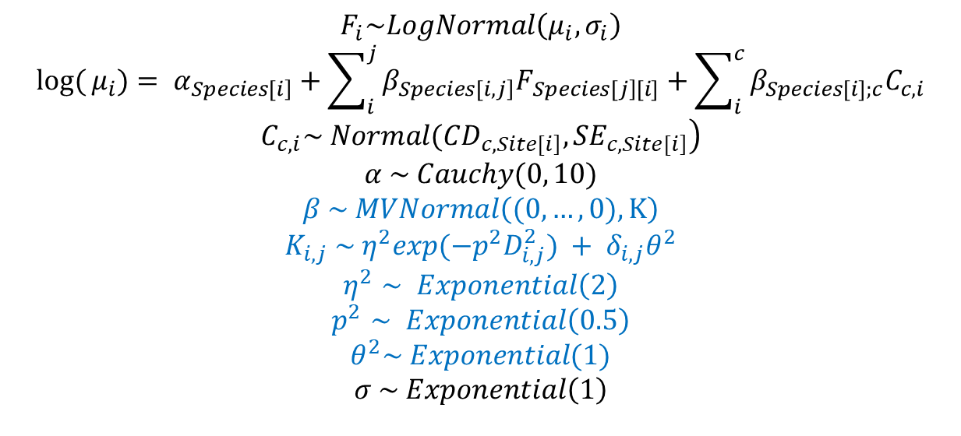
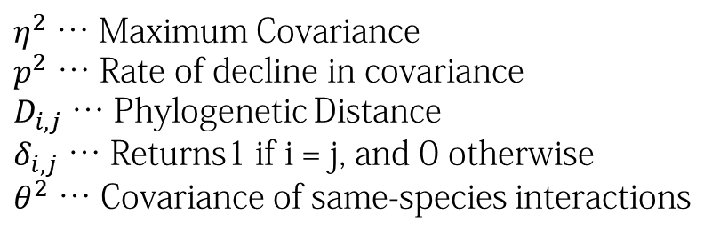
Method Development - Phylogenies
Time-Constraints |  | Species interactions are shaped through time.
Shared evolutionary history:
Affects interaction patterns of all types (Morales-Castilla et al., 2015)
Can be used to infer likely interactions (Galiana et al., 2021)
Application in R:
V.PhyloMaker R package (Jin & Qian, 2019)
Phylogenies inform about evolutionary history.
$$F_{i}\sim LogNormal\left(μ_{i},σ_{i}\right)$$
$${\log{(}μ}_{i})= α_{\left.Species[i\right]}+\sum_{i}^{j}{β_{\left.Species[i,j\right]}F_{\left.Species[j\right][i]}+\sum_{i}^{c}{β_{Species[i];c}C_{c,i}}}$$
$$\left.C_{c,i}\sim Normal({CD}_{\left.c,Site[i\right]},{SE}_{\left.c,Site[i\right]}\right)$$
$$α \sim Cauchy(0, 10)$$
$$β \sim MVNormal\left((0, …, 0), K\right)$$
$$K_{i,j} \sim η^{2}exp(−p^{2}D_{i,j}^{2}) + δ_{i,j}θ^{2}$$
$$η^{2}∼ Exponential\left(2\right)$$
$$p^{2}∼ Exponential\left(0.5\right)$$
$$θ^{2}\sim Exponential(1)$$
$$σ \sim Exponential\left(1\right)$$
$η^{2}$ … Maximum Covariance
$p^{2}$ … Rate of decline in covariance
$D_{i,j}$ … Phylogenetic Distance
$δ_{i,j}$ … Returns1 if i = j, and 0 otherwise
$θ^{2}$ … Covariance of same-species interactions
Notes:
19.44

Slide 36
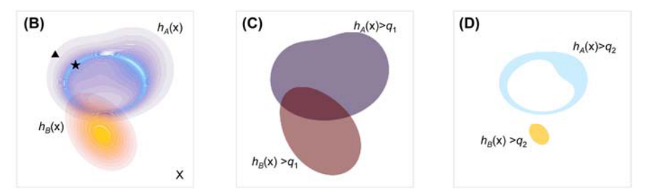
Method Development – Species Traits
Species-Traits |  | Functional trait expressions of species can modulate species interactions.
Accounting for functional trait expressions:
What for?
Account for limiting similarity (D’Andrea & Ostling, 2016 ; Macarthur & Levins, 1967)
A posteriori exclusion of unlikely/impossible interactions (Morales-Castilla et al., 2015)
How?
Types of traits:
Functional (Nock et al., 2016)
Demographic (Salguero-Gómez, 2017)
Subset of available traits
Biological theory (Westoby & Wright, 2006; Wright et al., 2004)
Data-driven (Díaz et al., 2016; Laughlin, 2014)
Calculate pair-wise similarity of species
→ Nearest-Neighbour Distances (Kraft et al., 2008)
→ Hypervolume-Overlap (Blonder et al., 2014; Blonder, 2018)
(Blonder, 2018)
Notes:
21.50
Which traits do you want? How do they link to interactions?
Link to demographic traits better
FT: performance Demographic: Fitness
Can I space these columns out?

Slide 37
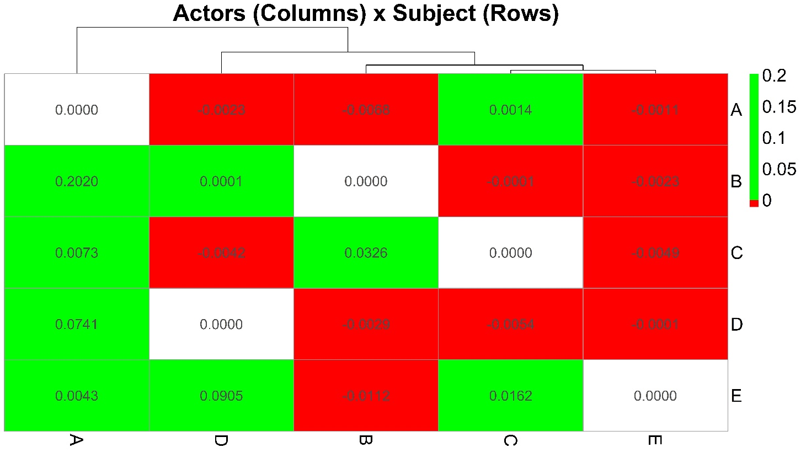
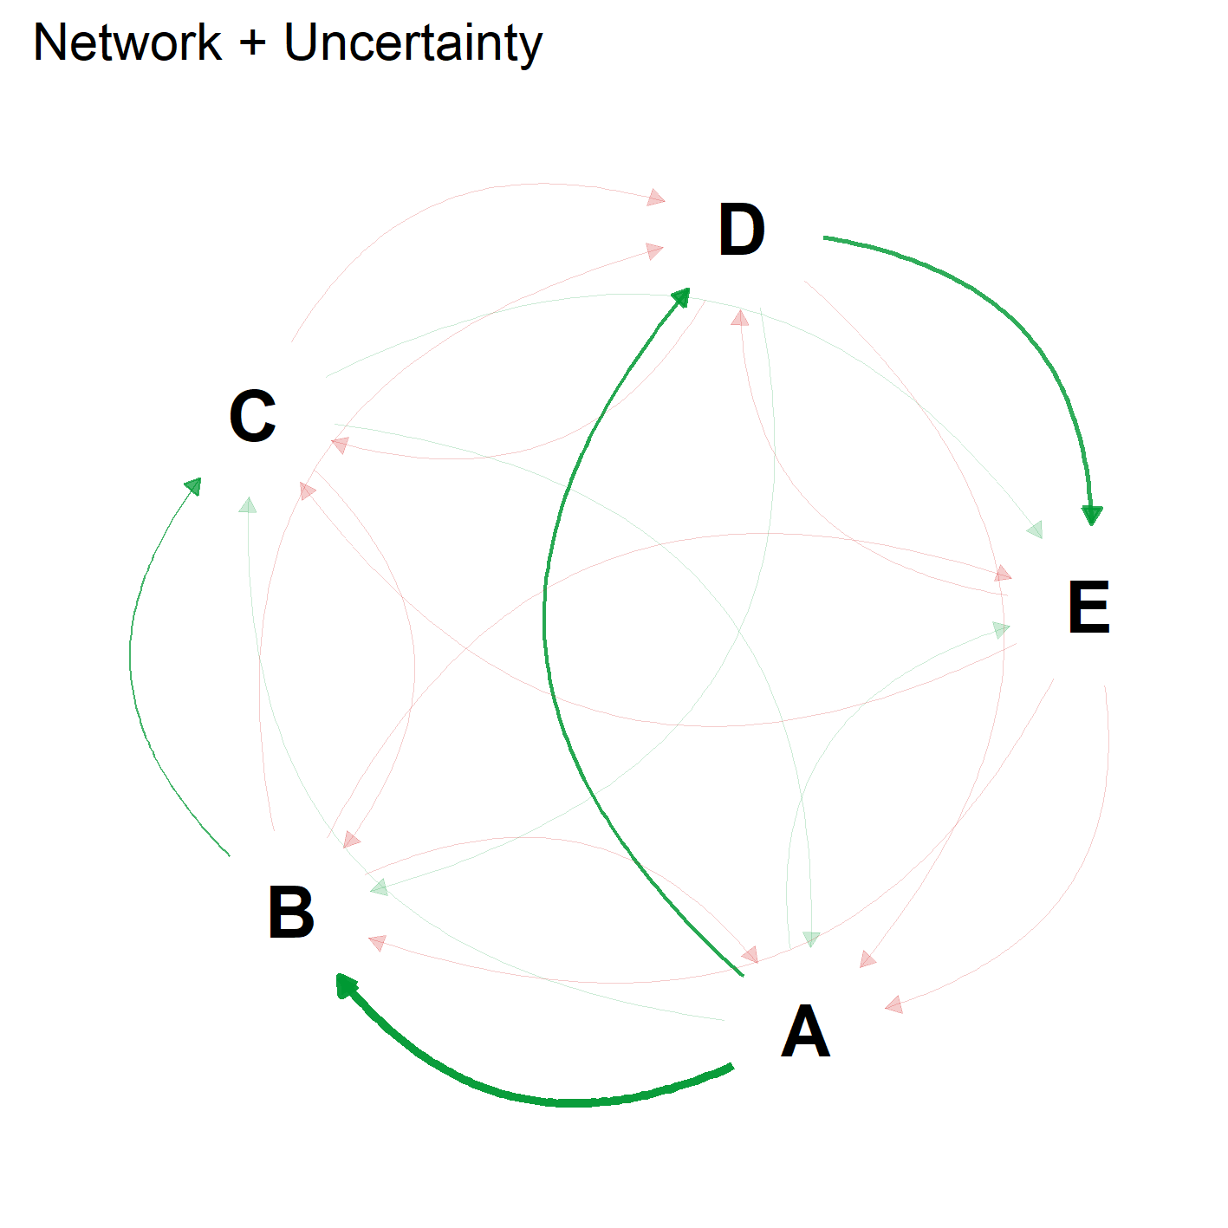
From Interactions to Network and Topology
Network Topology:
igraph R-package (Csardi & Nepusz, 2006)
Comparison across and within scales
Notes:
22.30
Representation of real interactions associated with fully propagated uncertainty

Slide 38
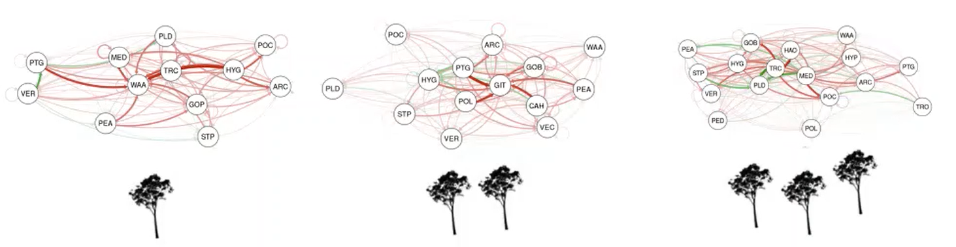

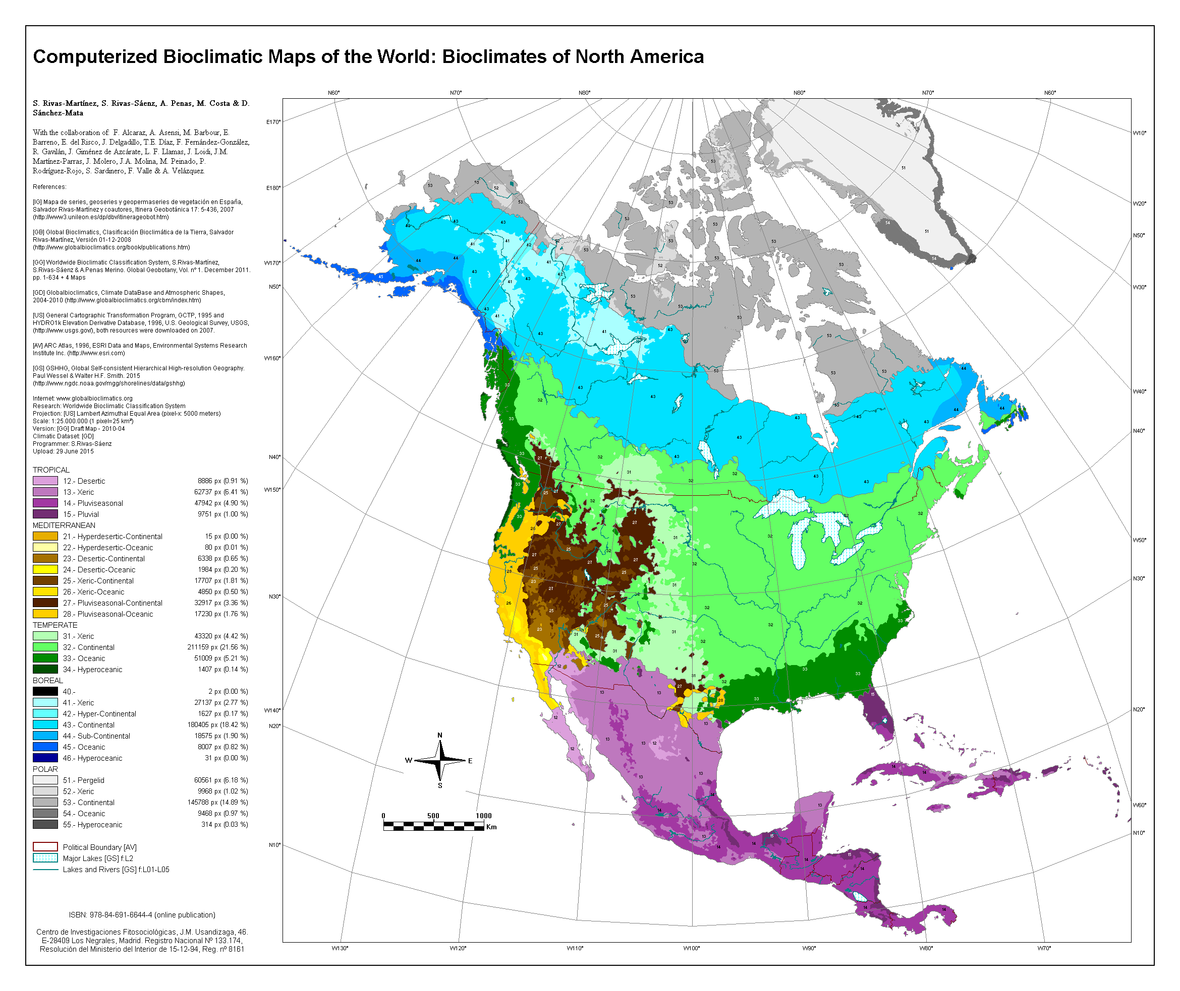
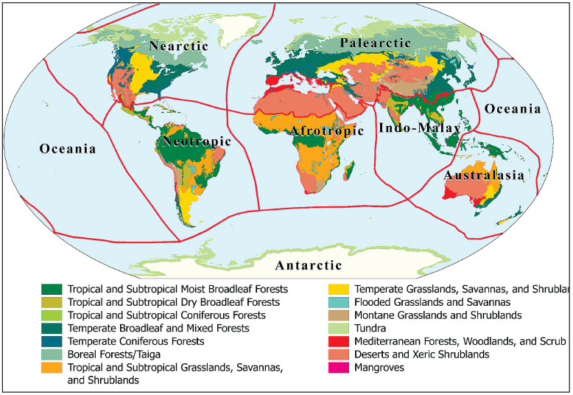
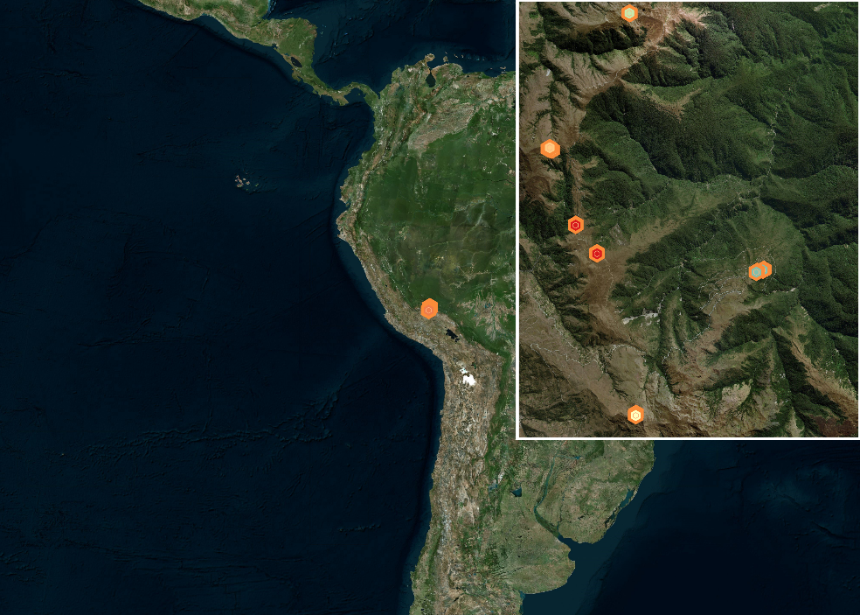
Cross-Scale Analyses
Species-Interaction Networks demonstrated to vary with environmental factors:
→ Biodiversity → Community Structure → Ecosystem Resilience
What happens at larger scales?
Does network topology reflect experimental treatments in plot-level experiments?
Does network topology reflect the membership of communities to ecoregions/biogeographical regions?
© Mayfield & Bimler
https://www.globalbioclimatics.org/form/maps.htm
Olson et al., 2001
Notes:
24.10
Mention Bimler plot size as very tiny

Slide 39
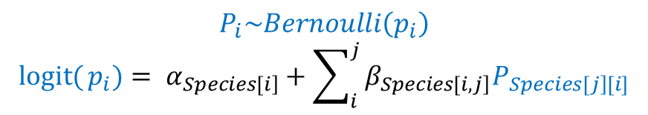
Data
$$P_{i}\sim Bernoulli\left(p_{i}\right)$$
$${\operatorname{logit}{(}p}_{i})= α_{\left.Species[i\right]}+\sum_{i}^{j}{β_{\left.Species[i,j\right]}P_{\left.Species[j\right][i]}}$$
Plant data sets.
Data Type | Functional Data | Plot Data | Occurrences | Range
Presence Indicator | Abundance/Coverage |  | Presence/Absence
Data Source | Observed/Measured |  |  | Inferred
Biotic Data | Functional Traits, Fitness, Proximity | Fitness, Proximity
Abiotic Data | Location-data of weather/climate |  |  | Climate layers
Geographic Scale | Highly-Localised Plot Experiments | Ecoregions | Biogeographical Realms / Global
Geographic Scale
Notes:
25.00

Slide 40

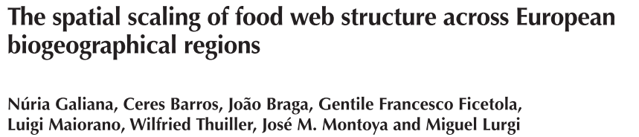
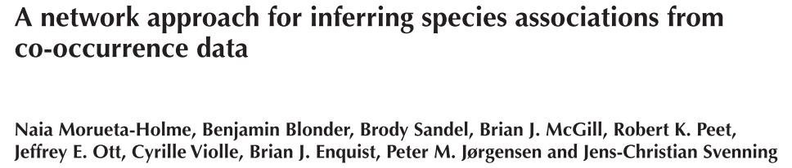
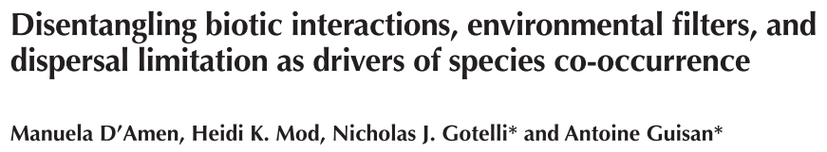
Cross-Scale Expectations
Geographic Scale
Network-Level Topology:
Heterogeneity of communities increases
Resilience increases as geographic scales increase
Vertex-Level Topology:
Larger biodiversity and more numerous ecosystem functions
Singular keystone species affect larger networks less
Notes:
26.22

